Slide 1
The 226th General Assembly
Salt Lake City, 2024
This is an overview to learn more visit: https://www.pc-biz.org/
Consent Agenda: https://www.pc-biz.org/agenda

Slide 2
Election of the Co- Moderators

Slide 3
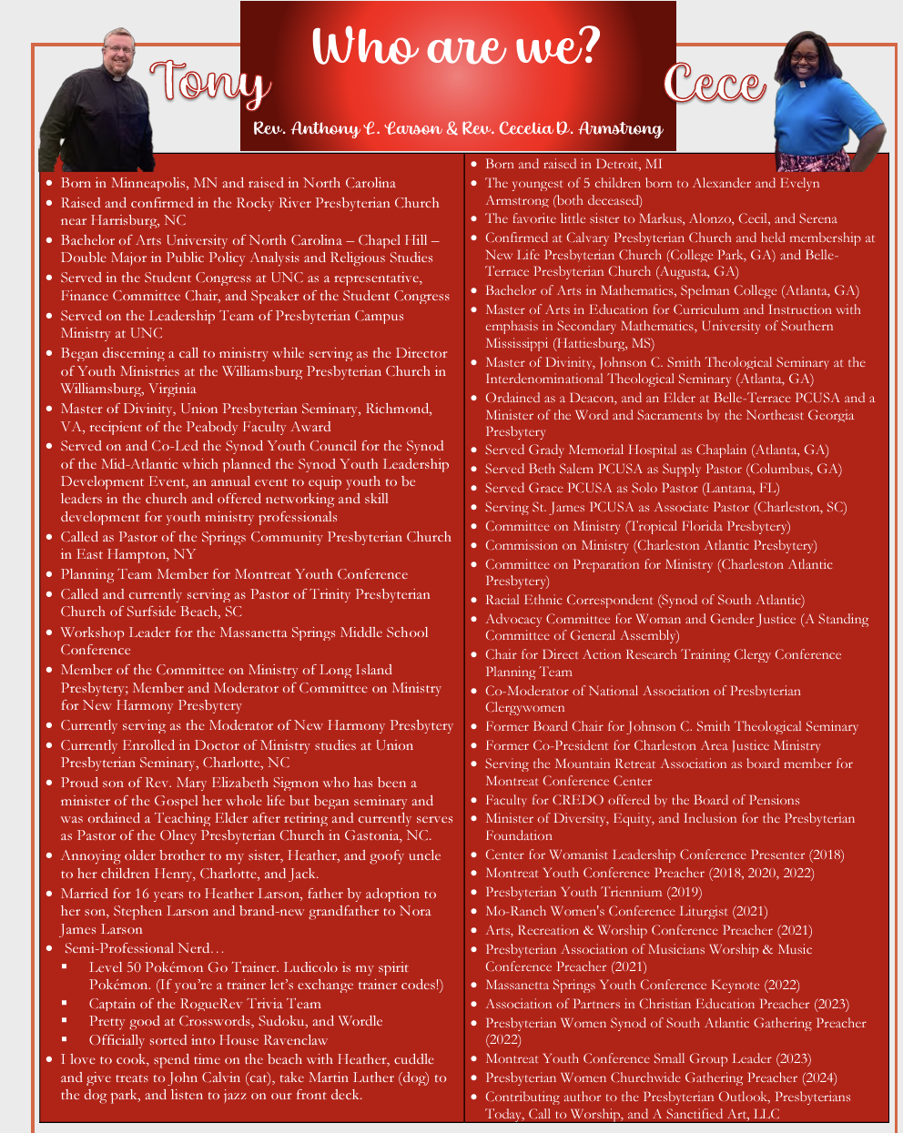

Slide 4
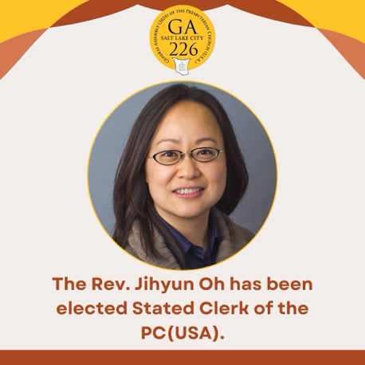
Election of Stated Clerk

Slide 5
Unifying Budget (new website coming soon)
VISION FOR THE 2025-26 UNIFYING BUDGET We envision that this budget will enable us to be … A partner in mission and ministry, complementing and strengthening congregations, mid councils and other faith communities, and stewarding faithfully all of our resources. This budget equips the PC(USA) to be … formed and re-formed as a covenant community of vibrant and growing disciples who embody a fresh expression of a Reformed witness to Christ’s love and justice in the world present and responsive to the challenges of this time.
VALUES FOR THE 2025-26 UNIFYING BUDGET Led by the Spirit, we will be … • Open to discerning and embracing new ways of embodying our work • Courageous, willing to risk failure as we pursue new possibilities • Centered in equity and justice, and • Trustworthy colleagues and partners in ministry As we are sent outward in service to church and world.

Slide 6
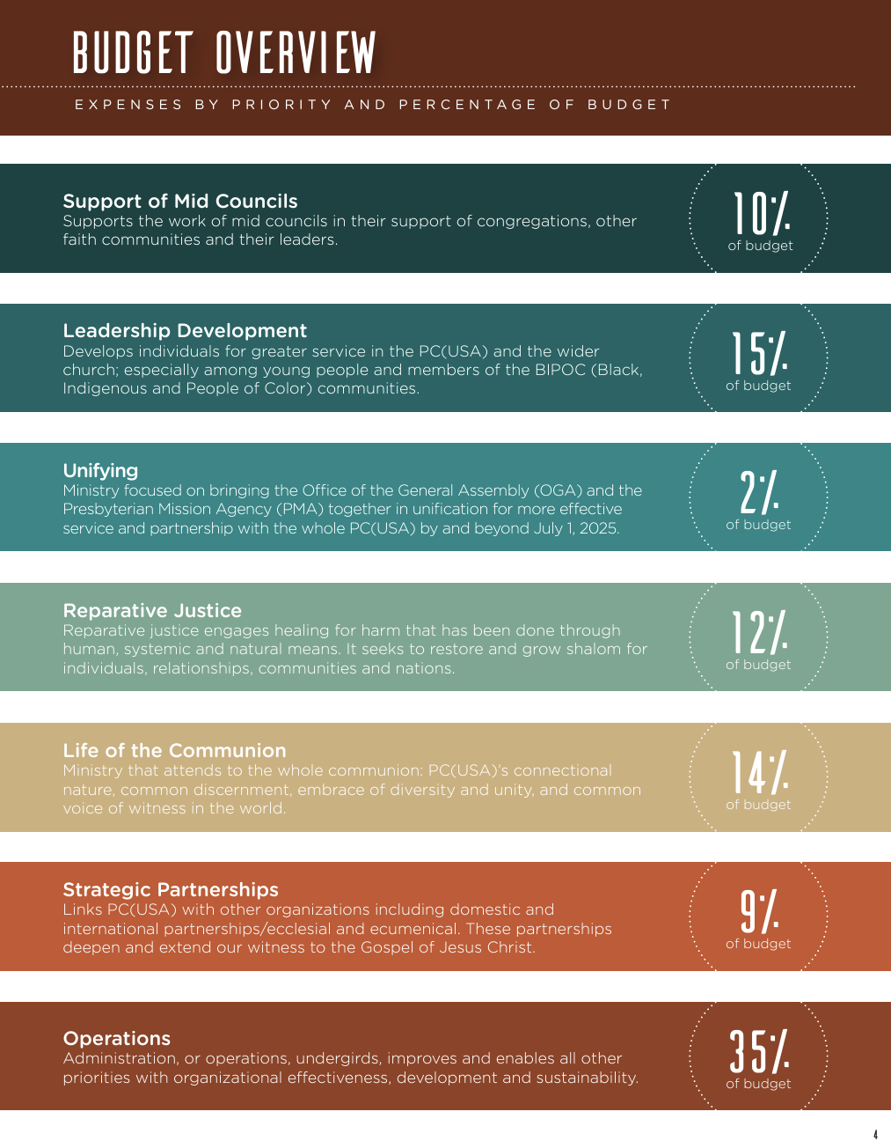

Slide 7
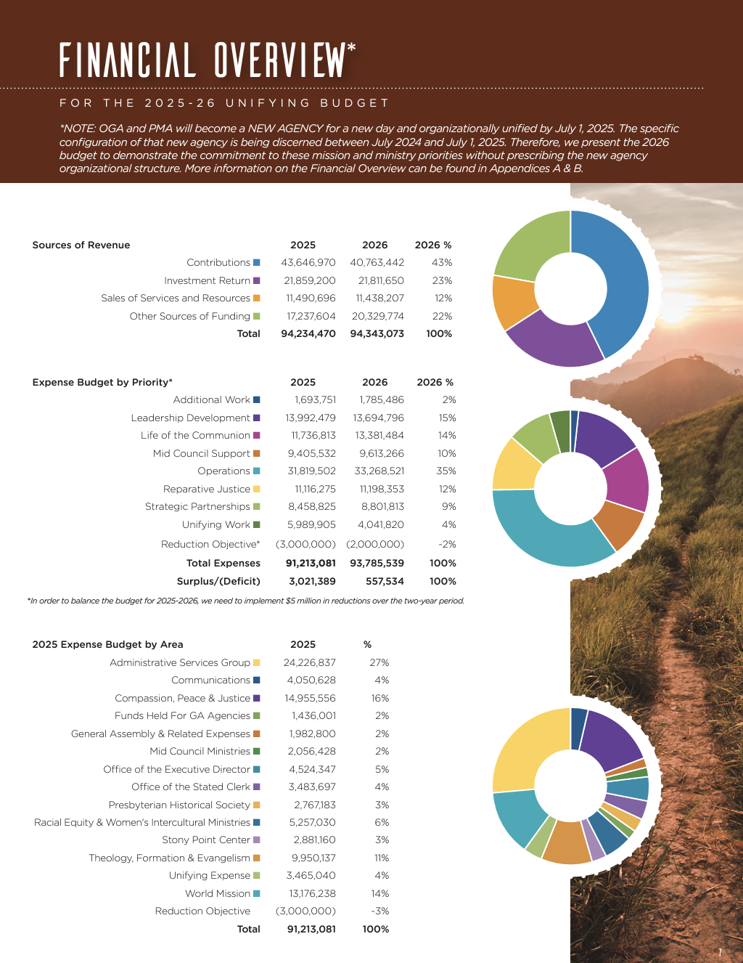

Slide 8
Special Offering Task Force, FIN-12
The Presbyterian Mission Agency Board (PMAB) recommends that the 226th General Assembly (2024) approve the following recommendations of the Special Offerings Review Task Force:
1. That the [NewGov1] of the [NewAg2] shall, on a six-year cycle, provide a task force for the review and evaluation of the Churchwide Special Offerings (and its primary promotional tools, e.g. The Presbyterian Giving Catalog) including their role as tools of engagement with lower councils of the Church, the recipient programs and ministries, and the consideration of new or different Special Offerings purposes and structures in light of established criteria, for recommendation by the [NewGov] to General Assembly.
2. That a new cycle of Churchwide Special Offerings be launched beginning in 2026 that includes the following three Churchwide Special Offerings.:
· Christmas Joy Offering
· One Great Hour of Sharing
· World Communion Offering

Slide 9
Ordination Committee
Approval of an Authoritative Interpretation: Defined Shared Ministry
Most of the business was referred to the Task Force to Explore the Theology and Practice of Ordination) Authorize the extension of the work of the committee with a final report due to the 227th General Assembly (2026), adding to the committee: two members, one Minister of Word and Sacrament who has been ordained within the last five years and an individual currently enrolled as an Inquirer or Candidate working towards ordination as Minister of Word and Sacrament, and liaisons identified and delegated by each of Racial Equity Advocacy Committee (REAC), Advocacy Committee for Women and Gender Justice (ACWGJ), and Advocacy Committee for LGBTQIA+ Equity (ACQ+E) who are a current member, former member, or representative to be appointed and given voice.

Slide 10
Christian Formation
Confirmation of Election of President of Austin Presbyterian Theological Seminary; Columbia Theological Seminary; Louisville Presbyterian Theological Seminary; Princeton Theological Seminary; Union Presbyterian Seminary.
A Covenant Between the General Assembly of the Presbyterian Church (U.S.A.) and Omaha Presbyterian Seminary Foundation and the Confirmation of New Trustees Elected by Presbyterian Church (U.S.A.) Theological Institutions

Slide 11
Committee on Race, Sexuality, and Gender Justice
The Advocacy Committee for Women and Gender Justice (ACWGJ) and the LGBTQIA+ Equity Advocacy Committee (ACQ+E) recommend that the 226th General Assembly (2024) direct the Presbyterian Mission Agency (or any Successor Agency) to recognize March 31st as Transgender Day of Visibility in all future printings and distributions of the planning calendar.
Also approved a Resolution Addressing Diversity, Equity, Inclusion, and the Realities of Hispanic Latino-a-e Ministry

Slide 12
Committee on Ecumenical and Interfaith Partnerships:
Direct the Office of Ecumenical & Interreligious Relations to:
1. Adopt a more flexible process as we had in developing the Formula of Agreement, where we can develop and grow into a relationship of shared ministry with global partner denominations with organized fellowships and congregations in the USA. 2. Establish regular dialogues with denominations such as Gereja Masehi Injili di Minahasa (GMIM) and the Evangelical Presbyterian Church, Ghana (EPC,G) that wish to collaborate with the PC(USA) on their presence and ministry in the USA to address any issues encountered in such collaboration and to identify any changes that might be called for of the sponsoring denominations to better support such international intercultural arrangements, and 3. Work together with the team of Intercultural Associates in Racial Equity & Women’s Intercultural Ministries and the LGBTQIA+ Equity Advocacy Committee on education for presbyteries on ecumenical hospitality in such situations, making known the options and resources that are available to presbyteries to encourage and support such "shared ministry."

Slide 13
Create a taskforce of seven (7) individuals to write a new study document (or multiple documents) in response to ECU-07 the Statement “Denouncing Antisemitism and Islamophobia" (2022). This new document shall be presented to the 227th General Assembly (2026), and will seek to accomplish the following objectives: 1. Address issues of violence, hatred, and prejudice towards Jews, Muslims, Arabs, and middle Eastern Christians within the bounds of the PC(USA). 2. Make clear the purpose and intent of the document outside the interests of the writing team. 3. Use more precision in language, particularly regarding terms like Semite and anti-Semitic (perhaps using the terms anti-Jewish or anti-Muslim). 4. Incorporate the lived experience of multiple parties from the region. 5. Include the equitable participation and recognition of women’s lived experiences. 6. Speak to the current global climate. This seven (7) person team shall be appointed by the Co-Moderators of the 226th General Assembly in consultation with the GACIER and the GA Nominating Committee, and may include at least one (1) Commissioner from the 226th General Assembly (2024); and may consult individuals from outside the PC(USA) membership; and will center, not just include, Arab and Middle Eastern Christian voices.

Slide 14
Committee on Environmental and Climate Justice:
▸Adoption of the One Billion for Peace Pledge: "Sustainable peace entails the physical, material, psychological, cultural/religious, and ecological well-being of all peoples. We declare our organizational intention to pursue sustainable peace in our work and our lives” ▸On Removal of Investments In and Subsidies For Fossil Fuels: disapproved ▸On Becoming Free from Plastic Pollution ▸Lithium Mining Paper: Understanding that today lithium is critical to moving to a green economy, that there are currently negative environmental impacts from lithium mining, and that much mining is on Indigenous lands, the church’s public witness supports policies to: a. Ensure that Indigenous communities are provided Free, Prior and Informed Consent (FPIC) to any mining proposed on their lands. b. Advocate for an enforcement mechanism for FPIC. c. Affirm the need for well-funded research and development to: i. Find other solutions to lithium batteries. ii. Increase recycling of lithium batteries iii. Increase the lifetime of lithium batteries iv. Develop methods of mining less injurious to the environment and water.

Slide 15
Response to the 225th General Assembly Directive on Applying Environmental Policy and Continuing Corporate Engagement: Prioritize responses to the urgent needs associated with the existential threats of the climate crisis, including those related to limiting global warming to well below two degrees Celsius, as outlined in the Paris Agreement, including the addition to the agreement by the parties during the UN Climate Change Conference COP 28 calling for “transitioning away from fossil fuels in a just, orderly and equitable manner, accelerating action in this critical decade” and for PCUSA-related entities and members to promote and pursue comprehensive faithful responses to these threats, including removal of all investments in the fossil fuel industry. Learn more here: https://www.presbyterianmission.org/ministries/mrti/

Slide 16
ENV-02 Disapproved ENV-06 Amended and Approved
1. Prioritize responses to the urgent needs associated with the existential threats of the climate crisis, including those related to limiting global warming to well below two degrees Celsius, as outlined in the Paris Agreement, including the addition to the agreement by the parties during the UN Climate Change Conference COP 28 calling for “transitioning away from fossil fuels in a just, orderly and equitable manner, accelerating action in this critical decade” and for PCUSA-related entities and members to promote and pursue comprehensive faithful responses to these threats, including removal of all investments in the fossil fuel industry. 2. Commend the investing agencies of the Presbyterian Church (U.S.A.) for their work to provide options for congregations, mid councils, and individuals working for a fossil fuel-free future and encourage Presbyterians to explore these options provided by the Presbyterian Investment and Loan Program, Inc., the Board of Pensions of the Presbyterian Church (U.S.A.), the Presbyterian Church (U.S.A.) Foundation, and the New Covenant Trust Company. 3. Commend the 700 investors representing over $68 trillion in assets under management working through the Climate Action 100+ Initiative to get the largest 170 corporate greenhouse gas emitters to manage operations in line with the goals of the Paris Agreement. [4. Direct MRTI to immediately identify the top ten fossil fuel companies that derive the majority of their profits from the exploration, development, and production of fossil fuels and with which there will be no [[profitable promising]] engagement, and immediately divest from those companies.] 5. Direct MRTI to continue engaging companies identified by Climate Action 100+ that are a) headquartered in the United States, b) held by PC(USA) investing agencies, c) identified by MRTI for engagement in the 2025 and 2026 proxy seasons and d) do not primarily derive their income from the exploration, development, and production of fossil fuels; and to report back to the 227th General Assembly (2026) with possible divestment recommendations for the companies that are not moving towards compliance with criteria established by the 222nd (2016) and 223rd General Assemblies (2018), and affirmed by the 225th General Assembly (2022). 6. Direct MRTI to add Ameren to its list for focused engagement. These two companies join the list of Climate Action 100+ companies MRTI previously identified for focused engagement, which included, but was not limited to: American Airlines, Delta, ConocoPhillips, Duke Energy, Ford, General Motors, Occidental Petroleum, PPL Corporation and United Airlines. ▸Docket time for Treasury Department to Educate about Inflation Reduction Act

Slide 17
Committee on Mid-Councils
All business approved

Slide 18
Committee on International Engagement:
▸On Support of the People of Guatemala ▸That the Presbyterian Church (U.S.A.) Utilize the Gospel of Love as a Guiding Principle in its Advocacy and Humanitarian Efforts ▸On Confessing our Complicity in Christian Zionism ▸Educational Resources for Seeking Ways to End Israeli Apartheid ▸CR-05 On Reaching Out in Concern for the Presbyterian Reformed Church in Cuba and the People of Cuba

Slide 19
Committee on Domestic Engagement:
▸Internal Displacement Crisis within the United States ▸On Supporting An Amendment to the United States Constitution to Abolish the Exception in the 13th Amendment That Permits Those Who Are Convicted of a Crime to be Enslaved ▸An Overture Calling for Action so that Children May Live Free from Gun Violence A. Call upon every congregation in the PC(USA) to take some specific action of love and responsibility for children as part of the movement to prevent gun violence, understanding that taking any action collectively as a church is a witness of what it means to be united in Christ. B. Additionally, the 226th General Assembly calls upon the PC(USA) Office of Public Witness and the Presbyterian Decade to End Gun Violence to include secure gun storage and the other safety measures listed here in their ongoing gun violence prevention actions, advocacy and resources.

Slide 20
▸Advisory Committee on Social Witness Policy (ACSWP) White Christian Nationalism Recommended Study ▸ACSWP A.I. & Faith Recommended Study ▸On Adopting "Protecting Utah's National Monuments and Wildlands for Ecology and Justice”
▸On Solitary Confinement: 1. Urge all Presbyterians to call upon their city, state, and federal elected officials to enact legislative or administrative reforms ending prolonged solitary confinement in city, state and federal jails, prisons, and detention centers, whether privately or publicly run, recognizing that confinement in excess of 22 hours or more per day without meaningful human contact, in excess of 15 consecutive days, is a form of torture (United Nations, “The Nelson Mandela Rules,” as revised 2015; U.N. Convention against Torture). 2. Urge presbyteries, congregations, and individual Presbyterians to support and participate in the work of the Office of Public Witness and human rights groups, including the National Religious Campaign Against Torture, to end the torture of prolonged solitary confinement and prohibit solitary confinement for vulnerable populations in U.S. state and federal jails, prisons, and immigration detention centers. 3. Call upon the 50 states , all U.S. territories and holdings and the District of Columbia and the federal government to follow the recent examples of New Jersey, New York, and Connecticut in passing comprehensive legislation significantly reducing the number of people held in solitary confinement, including placing strict time limits on solitary confinement, providing therapeutic alternatives to solitary, and prohibiting solitary confinement for vulnerable populations: juveniles, pregnant people, disabled people, LGBTQIA+ persons, including those who are gender non-conforming, and seriously mentally ill people.

Slide 21
Committee on General Assembly Entity Coordination:
▸On Recognizing the National Caucus of Korean Presbyterian Churches as a Caucus of the Presbyterian Church (U.S.A.)- Disapprove
▸On Realigning Self Development of People with its Historical Purpose- Disapprove
▸On Asking the General Assembly to Work with the Board of Pensions to Adjust the Medical Plan: Work with the Board of Pensions to explore adjustments to be made to medical dues plans for Pastors and Spouse or Families to help alleviate the burden on small congregations and present options for medical coverage for pastoral leaders needing family, spousal, or child coverage in 2026 and beyond.

Slide 22
Committee on General Assembly Procedures:
Recommendation to Accept Invitation to Host the 227th General Assembly (2026) from the Presbytery of Milwaukee - from the Committee on the Office of the General Assembly

Slide 23
POLITY
You get to vote, so make sure you read all the materials at PCBiz!

Slide 24
POL- Part A and Part B
On Amending the Book of Order to Include Sexual Orientation and Gender Identity Among the Categories Against Which This Church Does Not Discriminate Shall F-1.0403 be amended as follows: “The unity of believers in Christ is reflected in the rich diversity of the Church’s membership. In Christ, by the power of the Spirit, God unites persons through baptism, regardless of race, ethnicity, age, sex, [gender identity, sexual orientation,] disability, geography, or theological conviction. There is therefore no place in the life of the Church for discrimination against any person. The Presbyterian Church (U.S.A.) shall guarantee full participation and representation in its worship, governance, and emerging life to all persons or groups within its membership. No member shall be denied participation or representation for any reason other than those stated in this Constitution.”
Part 2: Standards for ordained service reflect the church’s desire to submit joyfully to the Lordship of Jesus Christ in all aspects of life (F-1.02). The council responsible for ordination and/or installation (G-2.0402; G-2.0607; G-3.0306) shall examine each candidate’s calling, gifts, preparation, and suitability for the responsibilities of ordered ministry. The examination shall include, but not be limited to, a determination of the candidate’s ability and commitment to fulfill all requirements as expressed in the constitutional questions for ordination and installation (W-4.0404) the Historic Principles of Church Order (F-3.01), and in the principles of participation and representation found in F-1.0403. Councils shall be guided by Scripture and the confessions in applying standards to individual candidates.

Slide 25
On Amending D-7.0501 Regarding Minors and Vulnerable Adults: Shall D-7.0501 in the Book of Order be amended as follows: When a clerk of session or the stated clerk of a presbytery receives an allegation, without undertaking further inquiry, that clerk shall then report to the council only that an offense has been alleged without naming the [person] accused or the nature of the alleged offense and [shall] refer the statement of allegation promptly to an investigating committee, which shall conduct an inquiry as defined below. [Pursuant to G-4.0302, the clerk shall report to civil legal authorities any knowledge of harm, or risk of harm, related to the physical abuse, neglect, and/or sexual molestation or abuse of a minor or adult lacking mental capacity.] The clerk of session or stated clerk shall also inform the accuser of the disciplinary process and their rights and responsibilities in the process.

Slide 26
Other Items:
On Amending the Book of Order to Include Other Forms of Corporate Witness (Small Worshipping Communities, etc.)
On Amending D-7.0902 to Specify that Administrative Leave be Paid Leave
On Amending G-2.0504b: Shall Section G-2.0504b, Temporary Pastoral Relationships, be amended as follows: Titles and terms of service for temporary relationships shall be determined by the presbytery. A person serving in a temporary pastoral relationship is invited for a specified period not to exceed [twelve thirty-six] months in length, which is renewable with the approval of the presbytery.

Slide 27
CONT’D
On Dissolution of Pastoral Relationships 1. Shall G-2.0901 be amended as follows: An installed pastoral relationship may be dissolved only by the presbytery. Whether the minister of the Word and Sacrament, the congregation, or the presbytery initiates proceedings for dissolution of the relationship, there shall always be a meeting of the congregation to consider the matter and to consent, or decline to consent, to dissolution. [No non-disclosure agreement shall be allowable.] [(A non-disclosure agreement, also known as a confidentiality agreement, is an agreement that outlines confidential material, knowledge, or information that is to remain confidential. Such an agreement binds the party or parties who have signed it and prevents them from discussing any information included in the contract with anyone not authorized by the agreement.)] 2. Shall G-2.0504b be amended as follows: Temporary pastoral relationships are approved by the presbytery and do not carry a formal call or installation. When a congregation does not have a pastor, or while the pastor is unable to perform her or his duties, the session, with the approval of presbytery, may obtain the services of a minister of the Word and Sacrament, candidate, or ruling elder in a temporary pastoral relationship. No formal call shall be issued and no formal installation shall take place. Titles and terms of service for temporary relationships shall be determined by the presbytery. A person serving in a temporary pastoral relationship is invited for a specified period not to exceed twelve months in length, which is renewable with the approval of the presbytery. A minister of the Word and Sacrament employed in a temporary pastoral relationship is ordinarily not eligible to serve as the next installed pastor, co- pastor, or associate pastor.[When the temporary pastoral relationship ends, no non-disclosure agreement shall be allowable.] [(A non-disclosure agreement, also known as a confidentiality agreement, is an agreement that outlines confidential material, knowledge, or information that is to remain confidential. Such an agreement binds the party or parties who have signed it and prevents them from discussing any information included in the contract with anyone not authorized by the agreement.)]

Slide 28
On Amending G-3.0106, Administration of Mission: Shall the fourth paragraph of G-3.0106 be amended as follows: All councils shall adopt and implement the following policies: a sexual misconduct policy, a harassment policy, a child[,] [and] youth[, and adults with vulnerabilities] protection policy, and an antiracism policy. Each council’s policy shall include requirements for boundary training which includes the topic of sexual misconduct, and child sexual abuse prevention training for its members at least every thirty-six months.
▸ACC Summary Report with AI Recommendations and Editorial Changes: See Here

Slide 29
Authoritative Interpretations
Celebrating the Lord's Supper within an Electronic Worship Service: 1. That the 226th General Assembly (2024) approve the following authoritative interpretation regarding the Directory of Worship W-3.04 on the celebration of the Lord’s Supper: Recognizing the efficacy of the sacraments is based upon the Holy Spirit and scripture, and that online worship services promote and demonstrate church community, then it is appropriate to celebrate the Lord’s Supper through electronic means.
2. This authoritative interpretation allows congregations to offer the Lord’s Supper as a means of grace during online worship services until the 227th General Assembly meets to issue a fuller authoritative interpretation. In addition this issue will be referred to the Office of Theology and Worship to develop a fuller authoritative interpretation to be reported back to the 227th General Assembly.

Slide 30
AI
Request for Authoritative Interpretation On Waiving of Mandatory Training: The Polity Committee recommends the 226th General Assembly (2024) approve the following authoritative interpretation of G-3.0106:The Presbytery of the Cascades asks, “Can the presbytery waive the boundary training requirement for specific ministers who, due to age or other incapacity, are unable to participate in the training?” This request for an authoritative interpretation only asks about a presbytery’s authority to waive boundary training requirements. Because membership is defined and functions differently in different types of councils (see, e.g. G-3.0201, G-3.0301), this interpretation is limited to a presbytery’s authority. No opinion is offered or suggested about the authority of sessions, synods, or the General Assembly under G-3.0106. G-3.0106 states, in part: All councils shall adopt and implement the following policies: a sexual misconduct policy, a harassment policy, a child and youth protection policy, and an antiracism policy. Each council’s policy shall include requirements for boundary training which includes the topic of sexual misconduct, and child sexual abuse prevention training for its members at least every thirty-six months. G-3.0106 does not define the specific requirements for boundary training beyond the inclusion of “the topic of sexual misconduct, and child sexual abuse prevention training” (G-3.0106). A presbytery may therefore determine for itself what those additional requirements should be. A presbytery could, for example, decide to waive boundary training for persons who are incapacitated, with the caution that age, per se, is not an incapacity. Alternatively, a presbytery could require boundary training only for those members of presbytery who are actively engaged in ministry, with the presbytery defining what “actively engaged in ministry” means.

Slide 31
AI
Request for Authoritative Interpretation on Commission Composition Committee on International Engagement: The Polity Committee recommends the 226th General Assembly (2024) approve the following Authoritative Interpretation of G-3.0109: The Presbytery of the Cascades asks if a presbytery could lawfully elect a 13-person administrative commission “with 8 ruling elders and 5 ministers since that was what was possible based on those willing and able to serve?” G-3.0109 provides that presbytery, synod and General Assembly administrative commissions “shall be composed of ruling elders and Ministers of the Word and Sacrament in numbers as nearly equal as possible and sufficient to accomplish their work.” There are thus two distinct goals: a) that the number of ruling elders and the number of ministers be nearly as equal as possible, and that b) the total number of commission members be sufficient to accomplish the work. There is no authoritative interpretation of the words, “as nearly as equal as possible.” It is commonly assumed, however, that when an administrative commission has an odd number of members, the difference between the two types of members is limited to 1. This balance is commonly referred to as “parity.” It is also commonly assumed that a commission that does not meet the parity standard is out of order. As stated in G-3.0109, the total number of administrative commission members must “be sufficient to accomplish the work.” For example, if the only possible way a sufficient number of people could be gathered was by appointing 8 of one kind of member and 5 of the rest, then 8 and 5 were the “numbers as nearly equal as possible” (G-3.0109). The Form of Government was amended in 2010 to provide flexibility to councils for administration of mission, in line with a council’s own policies and manual of administrative operations (G-3.0106). Presbyteries thus have the flexibility to determine for themselves what constitutes “numbers as nearly equal as possible” (G-3.0109). Flexibility, however, is not a license for discrimination. “The councils of the church shall give full expression to the rich diversity of the church’s membership and shall provide for full participation and access to representation” (G-3.0103).

Slide 32
Final Items:
▸On Support of the People of Guatemala ▸That the Presbyterian Church (U.S.A.) Utilize the Gospel of Love as a Guiding Principle in its Advocacy and Humanitarian Efforts ▸On Confessing our Complicity in Christian Zionism ▸Educational Resources for Seeking Ways to End Israeli Apartheid ▸On Reaching Out in Concern for the Presbyterian Reformed Church in Cuba and the People of Cuba

